Slide 1
Welcome to online bus ticket booking
Name : Narayana Rao P
Emp ID : 347356

Slide 2
online bus ticket
E-Ticketing app is having so many features like online bus booking from one city to any city in India.

Slide 3
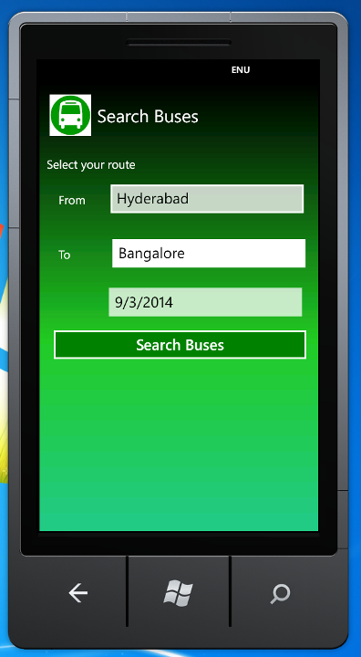
Route Selection
User needs to select from place ,To place ,date and click on the search buses.

Slide 4
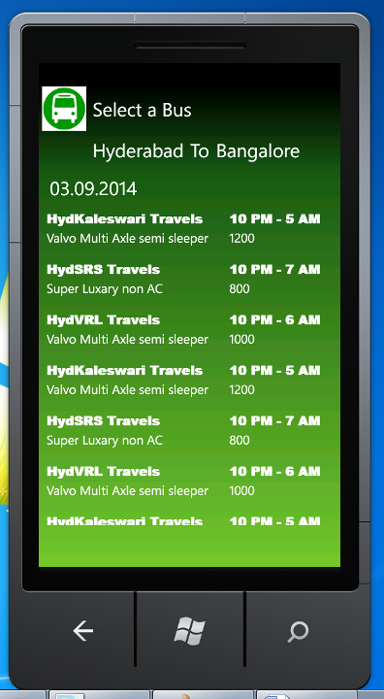
Available Buses
User will get list of available buses with timings and bus fares. If user selects any bus ,page navigate seat selection page.

Slide 5
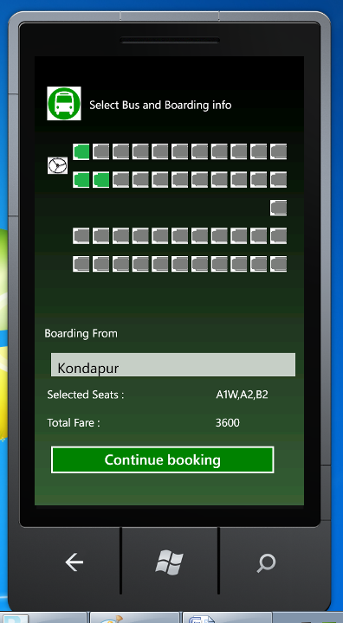
Seat Selection
Using this screen user can select multiple screens .Based on selection bus fares used to calculate and total amount will display in the bottom

Slide 6
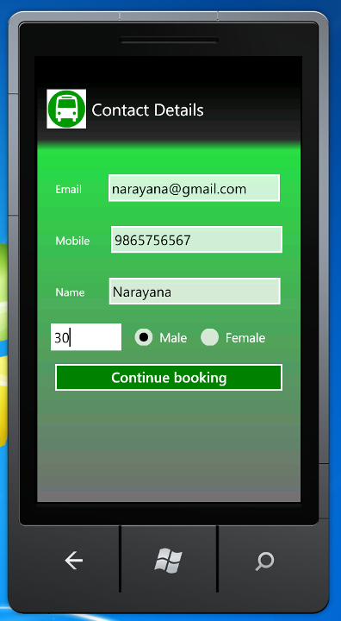
Contact Details
Using this screen user able to enter his contact details. If user clicks on the continue booking page will navigate to payment options.

Slide 7
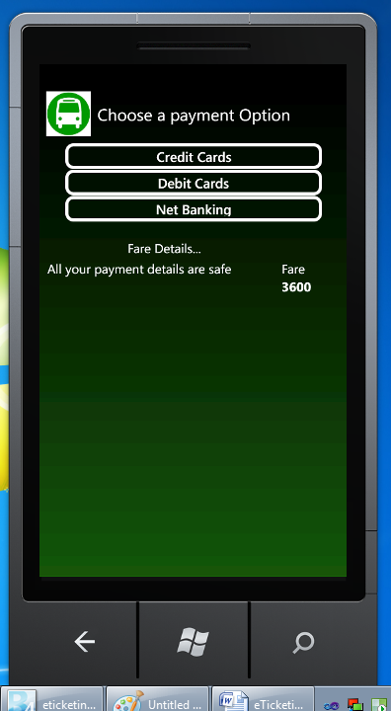
Payment Options
Using this screen user can select his convenient payment option.

Slide 8
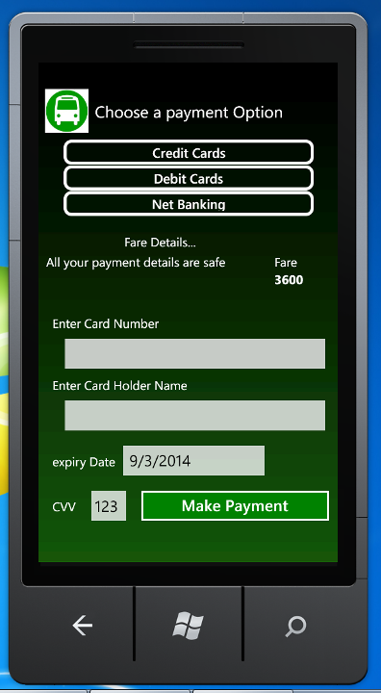
Credit/Debit Card Option
If user selects credit/debit card option ,user able to see the beside screen.

Slide 9
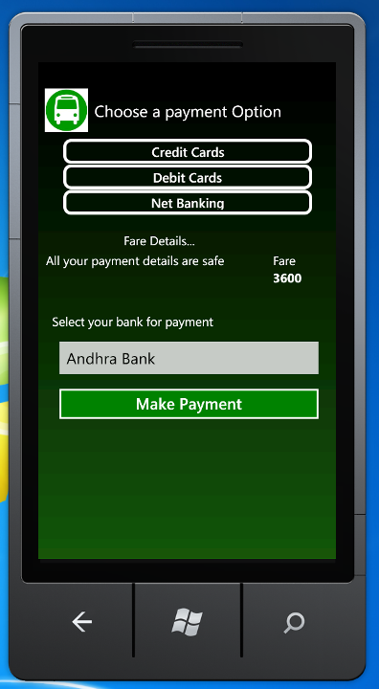
Net Banking Option
If user selects Net Banking option ,user able to see the beside screen.

